Slide 1
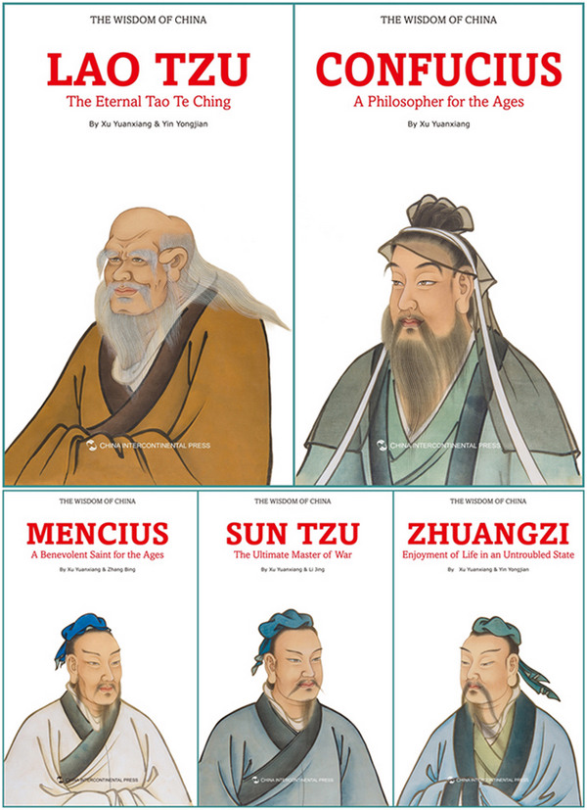
Chinese pholosophy

